Slide 1
3D Bioprinting in Tissue Engineering

Slide 2
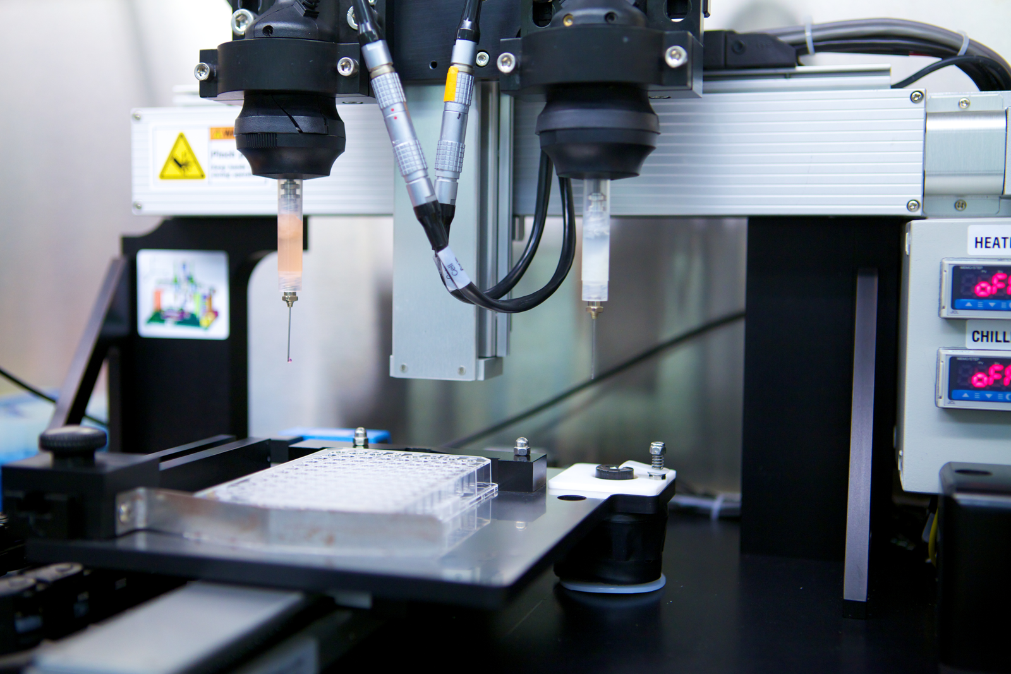
Parts of an typical bioprinter
Reservoir 2
Reservoir 1
Printing stage
+ Control system
Notes:
The printing “stage” is the platform where the materials are printed onto.
The reservoirs are loaded with two different types of biomaterials.
The control system has two components: the positioning controller and the dispensing controller:
For the positioning controller > the computer uses MRI/CT/CAD scans to control printer movement in the x, y and z directions
For the dispensing controller > the computer controls what cartridge is actively dispensing its material and at what rate

Slide 3
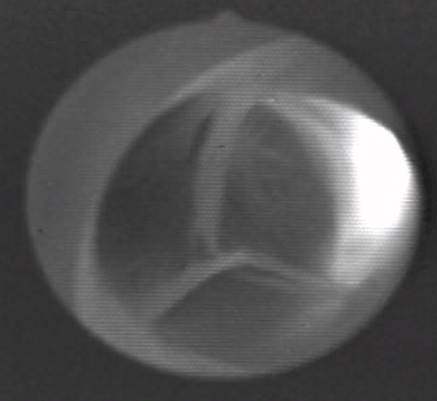
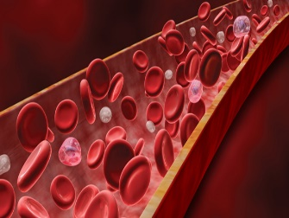
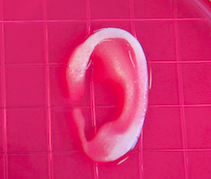
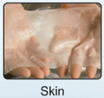
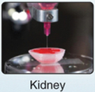
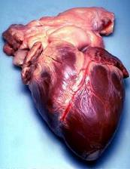
Applications of 3D bioprinting
Current
Tissue mimics for drug testing and screening
valves and vessels
Current/Near future
Future
Vascular Organs
Image 16
Image 17
aortic heart valve
blood vessels
cartilage
skin
kidney
heart
Notes:
Emphasize current applications:
Tissue mimics for drug testing and screening: We can create representative bodily tissue to test drug effects. We can create these tissues without 3D bioprinters, however using 3D bioprinters is a way to speed up and automate the process in order to expedite the drug testing process.
Non-transplantable tissues: Researchers can 3D printer heart valves and blood vessels in the lab. At this point, they are used only for research purposes and are not ready to be implanted in people. The black and white round image is a still image pulled from a video clip of a living, beating pig heart—an aortic valve—that was bioprinted in a lab. The heart was arrested, connected to the perfusion system and restarted. The working fluid was oxygenated balanced saline solution.
Near future applications (~15 years):
Transplantable tissues: We can create different types of tissue such as skin, kidney, liver, muscle, cartilage and bone. However, we have not developed a safe and consistent way of getting these tissues into people. This process requires more testing, Federal Drug Administration approval, and getting 3D bioprinters into hospitals.
Distant future applications (~20+ years):
Organ creation and transplantation: Many people who are on organ waitlists die because they do not receive an organ replacement in time. In the far future, we hope to be able to print organs with a person’s own cells. Ideally, we would take cells from the patient and put them in a lab. Then we would induce them to replicate. After we have enough cells from a particular organ, we could use these cells to 3D bioprint a new organ.

Slide 4
Bioprinting process, techniques, and applications. For human therapeutic applications, the typical workflow of bioprinting would involve the isolation and expansion of human cells prior to printing the desired cell-laden scaffold. These scaffolds could then ultimately be used as therapeutic devices themselves, as a testing platform for drug screening and discovery, or as an in vitro model system for disease

Slide 5
Examples of bioprinted tissues and organs. (A) Printed ear-shaped PCL and alginate scaffolds with bioinks localized to certain tissue regions. (B) Cartilaginous ear scaffolds printed using a novel nanocellulose–alginate bioink supported human chondrocytes

Slide 6
Bioprinting of layered grafts that mimic the organization of the native cartilage/bone tissue. See the following video:
https://youtu.be/ukul0bi9ytI

Slide 7
The Bioprinting Process
https://youtu.be/s3CiJ26YS_U

Slide 8
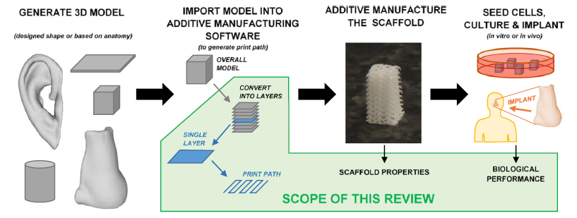
Overall procedure for additive manufacturing a tissue engineering construct. The scope of this review is to consider how the print path (equivalently referred to as filament orientation, lay-down pattern, or “scaffold design”) affects scaffold properties and performance

Slide 9
A custom print path generation algorithm. It is demonstrated for a) an ear geometry and b) a simplified multi-material construct, in which four different materials were printed on each individual layer. Colours of the filaments indicate polymer scaffold (white), two different cell-laden hydrogels (blue and red), and the polymer support material (yellow), which supports overhangs on subsequent layers. An illustrative 3D model for a cone is shown on the very right of the figure to illustrate the scales being considered in different sets of images.

Slide 11
A design map showing varies design factors in bioprinting which is essential for evaluation during the pre-printing stage

Slide 12
(B) Inkjet printers eject small droplets of cells and hydrogel sequentially to build up tissues. (C) Laser bioprinters use a laser to vaporize a region in the donor layer (top) forming a bubble that propels a suspended bioink to fall onto the substrate. (D) Extrusion bioprinters use pneumatics or manual force to continuously extrude a liquid cell–hydrogel solution. (E) Stereolithographic printers use a digital light projector to selectively crosslink bioinks plane-by-plane. In (C) and (E), colored arrows represent a laser pulse or projected light, respectively.

Slide 13
Cell types and patterning

Slide 14
Cell Patterning

Slide 15
Example: Idealized system for Heart Muscle Fabrication

Slide 16
An example scaffold was produced in Siemens NX 11 to demonstrate the complex geometry of pores within tissue engineering scaffolds.
A 3D CAD model for an example scaffold is shown in the top left. A 3D CAD model for the volume in between the scaffold filaments (i.e. the “pore”) is shown in the centre of the figure. The five-sectioned images to the right show the cross-sectional geometry of the 3D CAD model for the pore. The two images at the bottom-left show top views of the scaffold and pore to illustrate that “square” pores may be seen in microscopy characterisation of scaffolds, but the actual pore does not have a square morphology

Slide 17
Several printing strategies with different filament positions and orientations: a Scaffolds with a 0/90 orientation and 0/60/120 orientation are shown in the top four and bottom four images, respectively. b Scaffolds with aligned filaments are shown in the top two images and staggered filaments in the bottom two. c Standard infill patterns that are widely used outside the biomedical field but are also used in some tissue engineering scaffold studies.

Slide 19
Schematic showing different considerations when planning for bioprinting

Slide 20
Temperature sensor
Better resolution of filament widths and pore size with bioinks by controlling temperature of formulations
A) 3D bioprinting with bi-phasic support liquid for the manufacturing of thin-walled, multi-layered hydrogel structures. B) Schematic illustration of the velocity and shear stress distribution as well as the stress impinged on cells inside a bioprinter nozzle.

Slide 21
Complex 3D skin object printing. (A) 3D file used for printing human ear. (B,C) A printed adult size ear (8 cm) composed of bio-ink and human fibroblasts.

Slide 22
3D-Printed Organ Models
https://youtu.be/WkplBR4AZV4
3D printed heart
https://youtu.be/e276y5oSu2A

Slide 23
3D bioprinting of organs
https://youtu.be/i8uCs09BoNU

Slide 24
Temperature control in 3D bioprinting: Selecting the correct temperature according to Glass-transition temperature of material
The glass–liquid transition, or glass transition, is the gradual and reversible transition in amorphous materials (or in amorphous regions within semicrystalline materials), from a hard and relatively brittle "glassy" state into a viscous or rubbery state as the temperature is increased
When a polymer system is heated, significant changes occur in mechanical strength properties and thermal, electrical and chemical resistance which do not necessarily recover upon cooling.
While these changes generally take place over a limited temperature range, a single temperature called the glass transition temperature (T_{g}) is generally selected for convenience.
Polymeric compounds, which are exposed to a temperature below the T_{g}, exhibit much higher physical strength and stiffness, as well as greater electrical insulation, dimensional stability and chemical resistance than they do above their T_{g}.
Furthermore, performance upon structural loading is greatly enhanced. For convenience, the T_{g} is often considered the maximum sustainable operating temperature for a polymer system, especially in structural applications.

Slide 25
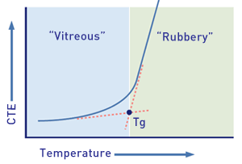
Tg: Glass Transition Temperature
CTE: Coefficient of thermal expansion
Example: Hard plastics like ABS, PMMA (Polymethyl methacrylate) have end use applications well below their glass transition temperatures that is in their glassy state. Their Tg values are well above room temperature, both at around 105 °C (221 °F). Rubber elastomers like polyisoprene and polyisobutylene are used above their Tg, that is, in the rubbery state, where they are soft and flexible.

Slide 26
Electrospinning as one example of bioreactors that have been used for scaffold fabrication.
Electrospinning is a method fabricating individual fibers of a polymer that can be combined in different configurations to promote 3-dimensional scaffold fabrication
Scaffolds have been fabricated using electrospinning with a wide array of polymers, including polylactic acid, poly(glycolide), polyurethane, polystyrene, collagen, fibrinogen, gelatin, hyaluronic acid, and chitosan
Fabrication of 3D artificial tissue requires cellularization of scaffolds.
In the simplest embodiment, cells are injected into complex 3D scaffolds using a syringe as the delivery vehicle, with multiple injections being required for cellularization
Success of the cellularization strategy is measured based on cell viability, cell retention, cellular alignment, uniform distribution of cells, and functional coupling between adjacent cells and with extracellular matrix

Slide 27
Electrospinning
Electrospinning is widely used to fabricate tissue engineering scaffold.
For simple geometries (e.g. sheet form), electrospinning can be utilised.
However, cells are difficult to infiltrate into the nanoporous structure of traditional electrospun scaffold by electrospinning.
For the reproduction of patient-specific anatomical geometries, however, the free-form nature of additive manufacturing processes makes them more appropriate.

Slide 28
Other methods of scaffold fabrication: Schematic of the Electrospinning process

Slide 29
Electrospinning for nanofibers production
https://youtu.be/hlHUVJkDuNo

Slide 30
Scanning electron microscope (SEM) images of a natural extracellular matrix (ECM) in distinct types of tissues with (a) isotropic direction and (b) anisotropic direction; (c) Schematic illustration of the electrospinning process; (d) Representative SEM images of fibrous scaffolds with a controllable fibrous scale with (d) randomly and (e) aligned fibrous deposition via electrospinning.

Slide 31
Comparison of scaffold fabrication methods
Manufacturing Method
Benefits
Potential Limitations
Electrospinning | Creates scaffold with large surface area for cell attachment Simple and inexpensive technique | Organic solvents may be required, which can be harmful to cells Limited mechanical properties Difficult to incorporate precise microarchitecture into constructs
3D Printing SLA Inkjet Laser-assisted Microextrusion | Complex 3D shapes with high resolution, controlled pore size & morphology and controlled internal structures can be fabricated. Improved capacity to incorporate vascular structures into constructs Depending on technique used, cells may be included in high concentration directly in scaffold materials | Some techniques are limited by printable materials Set up costs can be expensive for machinery

